Slide 1
MODULE : 11

Slide 2
Q. A cubical box has each edge 10 cm and another cuboidal
box is 12.5 cm long, 10 cm wide and 8cm high.
cuboidal
box is 12.5 cm long, 10 cm wide and 8cm high.
A cubical box has each edge 10 cm
(i) Which box has the greater lateral surface area and by how much ?
Which box has the greater lateral surface area and by how much
Soln.
Edge of cubical box =
10 cm
What is the formula for lateral surface area of a cuboid ?
For cuboidal box,
length (l) = 12.5 cm,
breadth (b) = 10 cm,
2(l + b) × h
height (h) = 8 cm.
Lateral surface area of cubical box of edge 10 cm =
What is the formula
for lateral surface
area of a cube ?
4 × 10²
4 (side)²
= 400 cm²
Lateral surface area of cuboidal box =
2(l + b) × h
=
2 ×
( 12.5
+ 10 )
× 8
=
2 ×
× 8
22.5
=
360 cm²
Thus, lateral surface area of the cubical box is greater than cuboidal box
and is more by
(400 – 360) cm²
i.e. 40 cm²

Slide 3
(ii) Which box has the smaller total surface area and by how
much ?
Total surface area of cubical box of edge 10cm =
6 × 10²
l = 12.5 cm
What is the formula for total surface area of a cube ?
= 600 cm²
6 × (side)²
b = 10 cm
Total surface area of cuboidal box =
2( lb + bh + hl )
h = 8 cm
=
2
(12.5
× 10
+ 10
× 8
+ 8
× 12.5)
=
2
(125
+ 80
+ 100)
=
2
× 305
= 610 cm²
What is the formula for total surface area of a cuboid ?
2(lb + bh + hl )
Thus, total surface area of cubical box is smaller than cuboidal box
and by
(610 – 600) cm²
i.e. 10 cm²

Slide 4
MODULE : 12

Slide 5
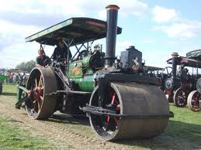
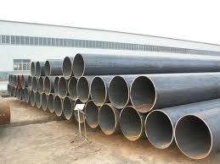
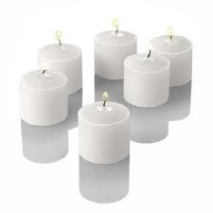
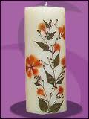
Right Circular Cylinder
Examples :
Let us see few examples
of right circular cylinder
Roller wheels
Pipes
Cylindrical candles

Slide 6
Right Circular Cylinder
The right circular cylinder has three faces.
r
1
1
Let us see a geometrical figure
of right circular cylinder
Two circular faces
How many curved faces
do we see here?
How many faces do
we see here?
How many circular faces
do we see here?
One face
Two faces
One curved face
Cylinder has radius ‘r’ and height ‘h’.
3
1
A cylinder has two circular
faces of same radii
h
Distance between these 2
centres is the height of
the cylinder
Let the radius be ‘r’.
Let the height of the
cylinder be ‘h’
Height is the
perpendicular distance
2
2
2
r

Slide 7
MODULE : 13

Slide 8
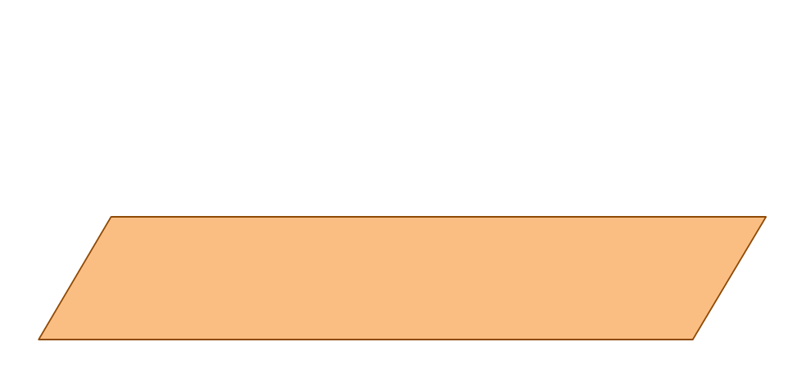
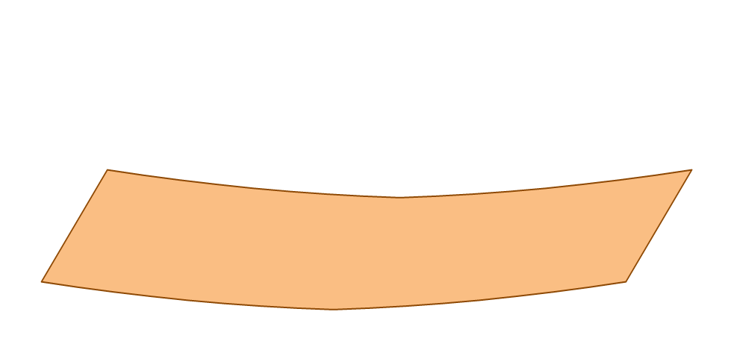
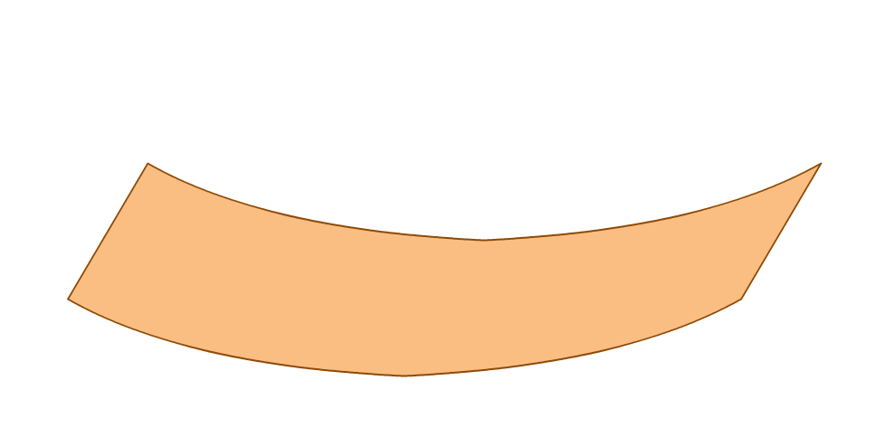
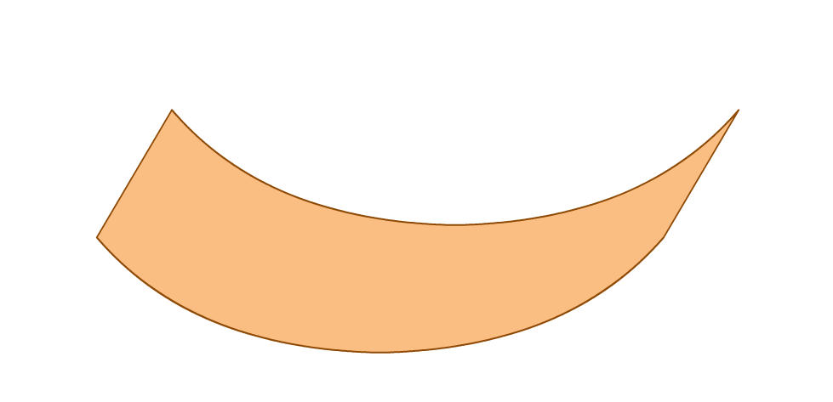
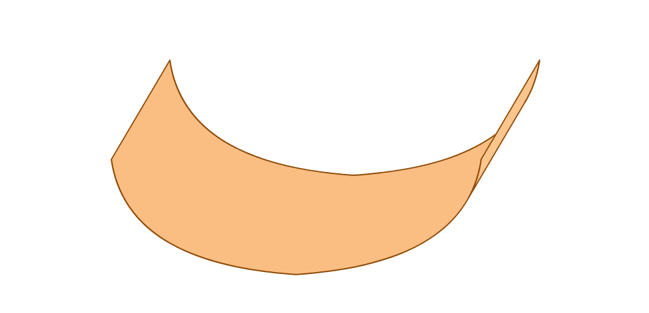
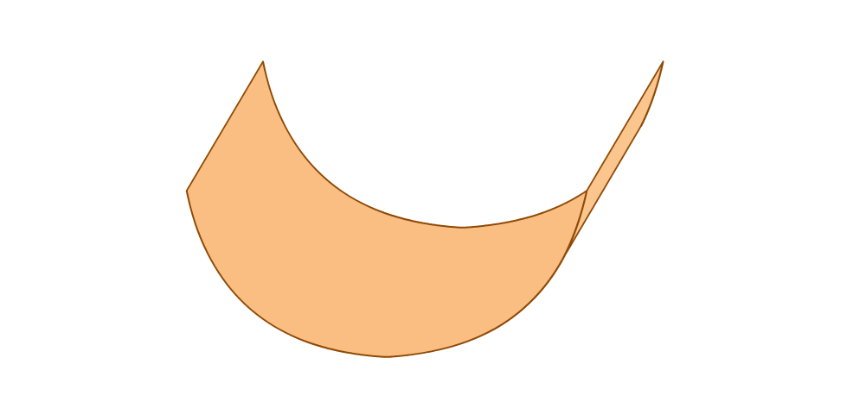
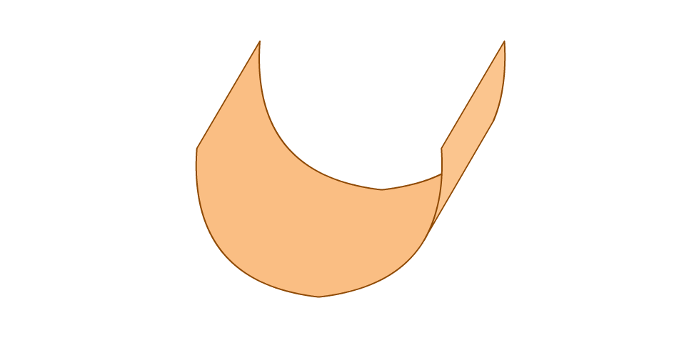
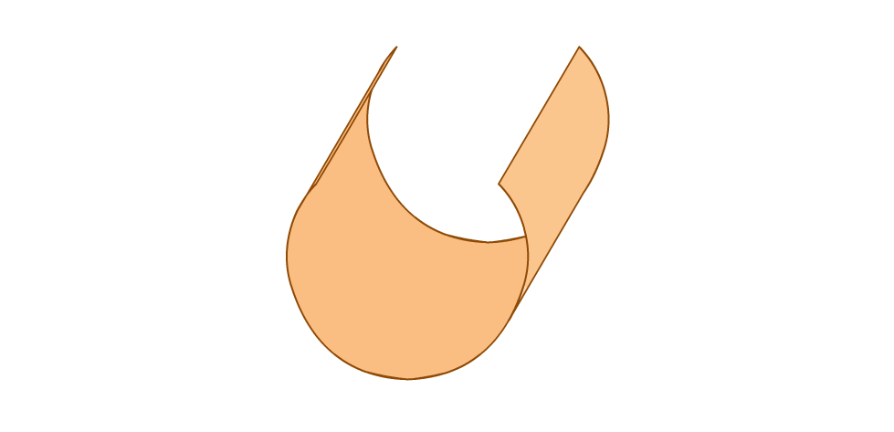
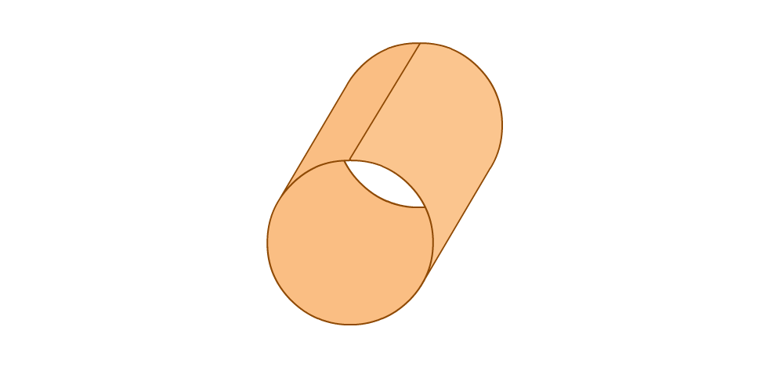


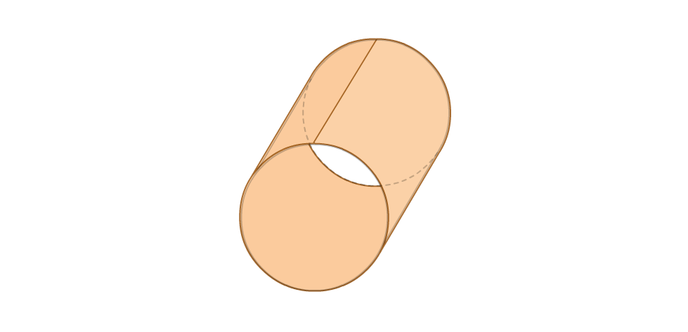

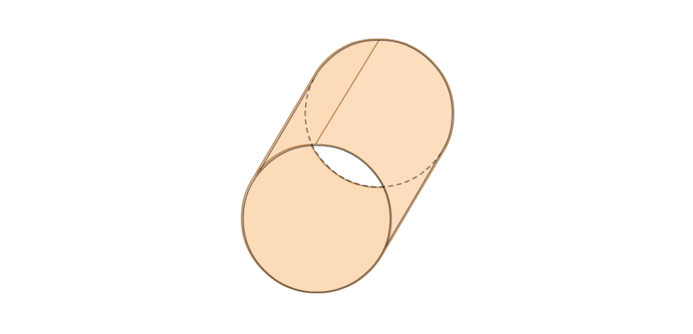
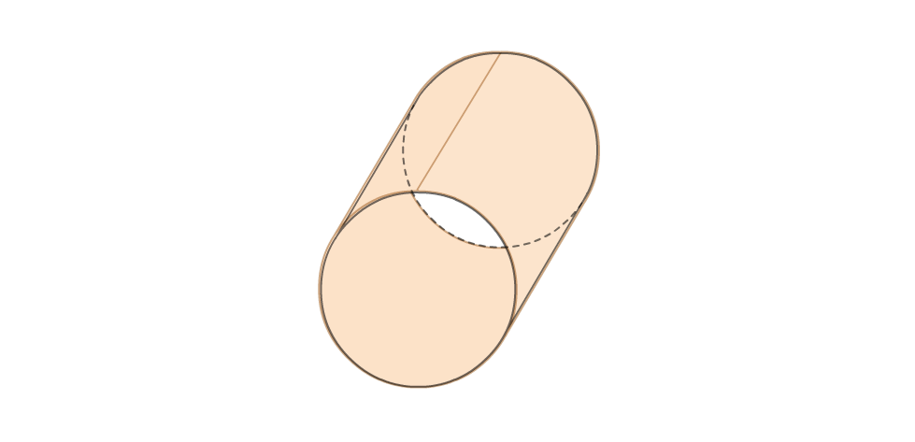
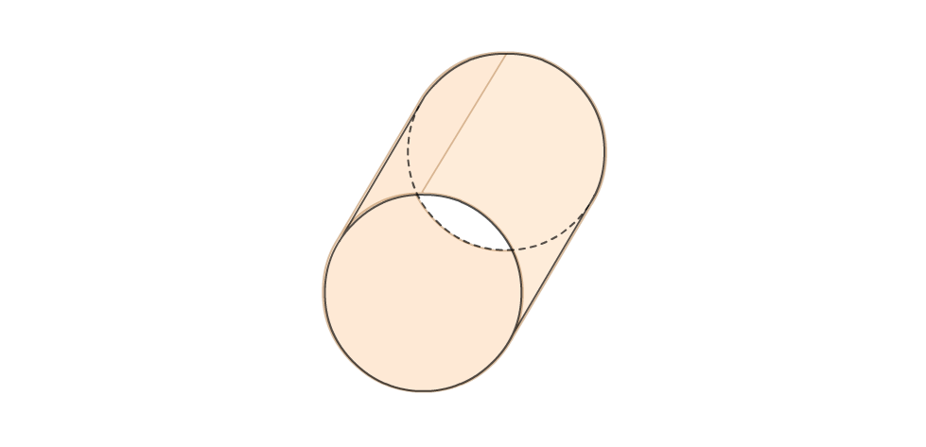
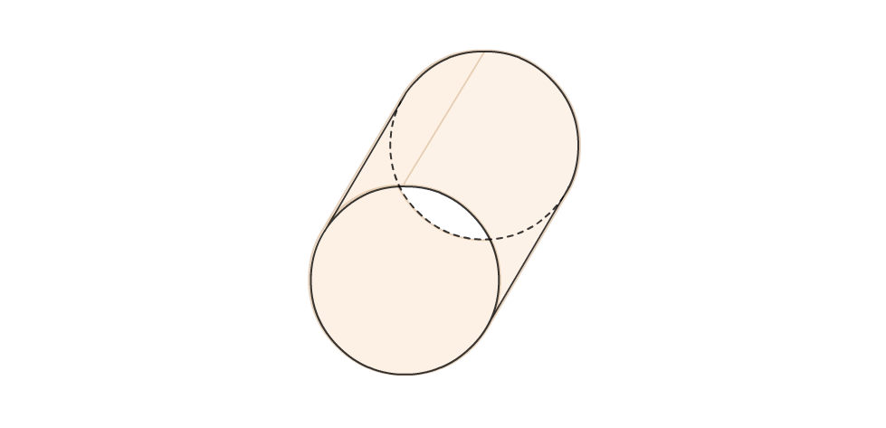
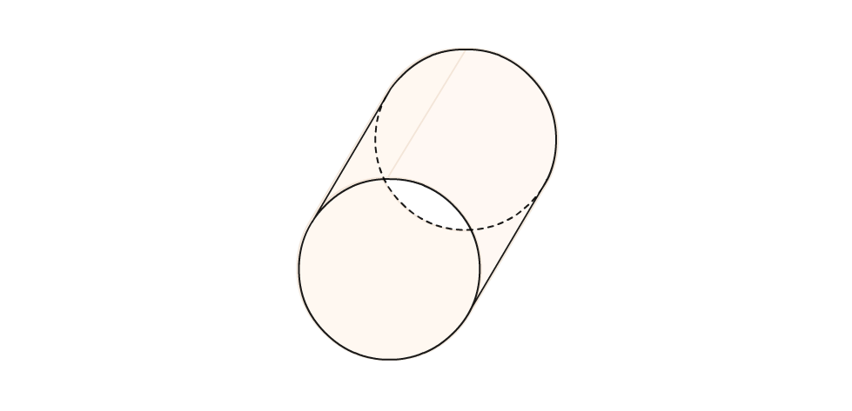
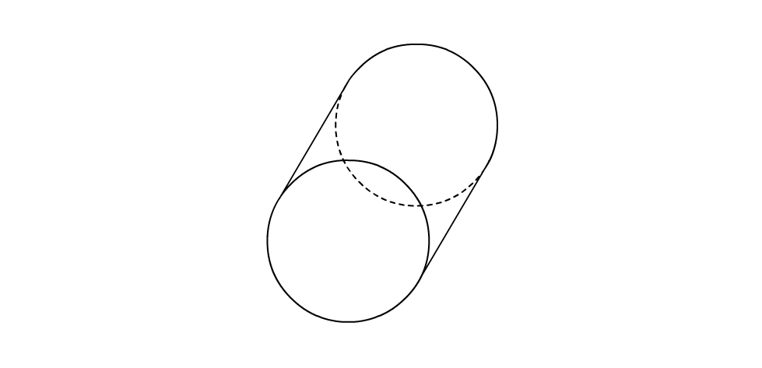
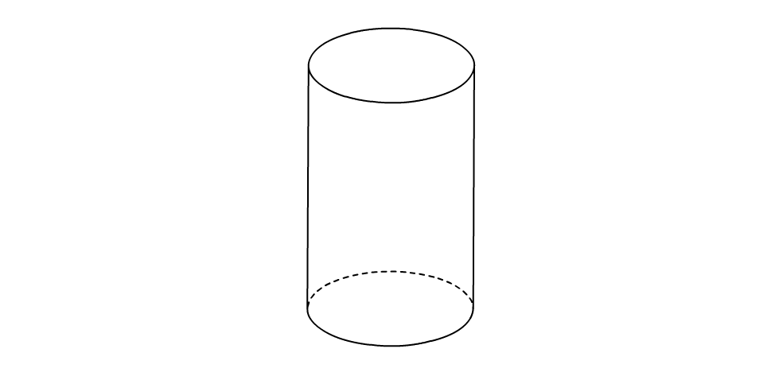
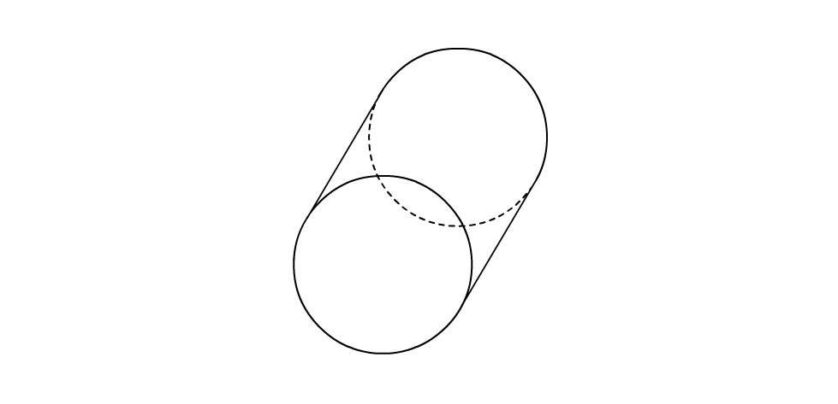
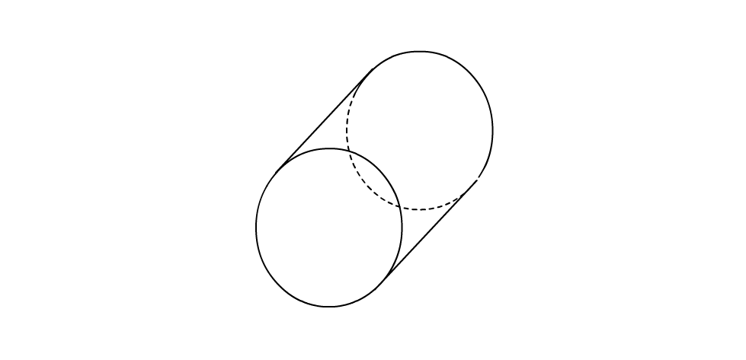
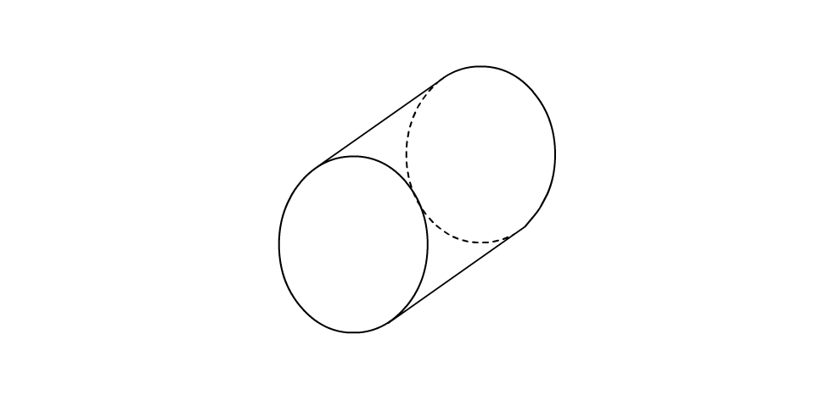
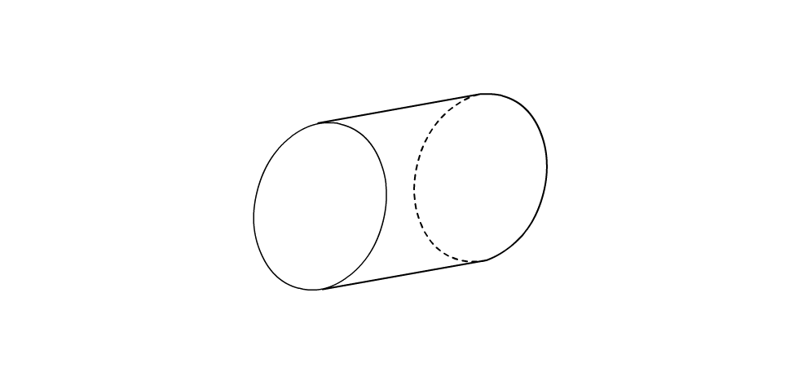
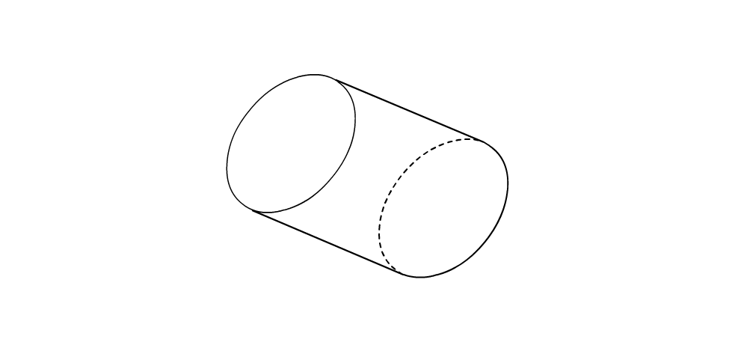
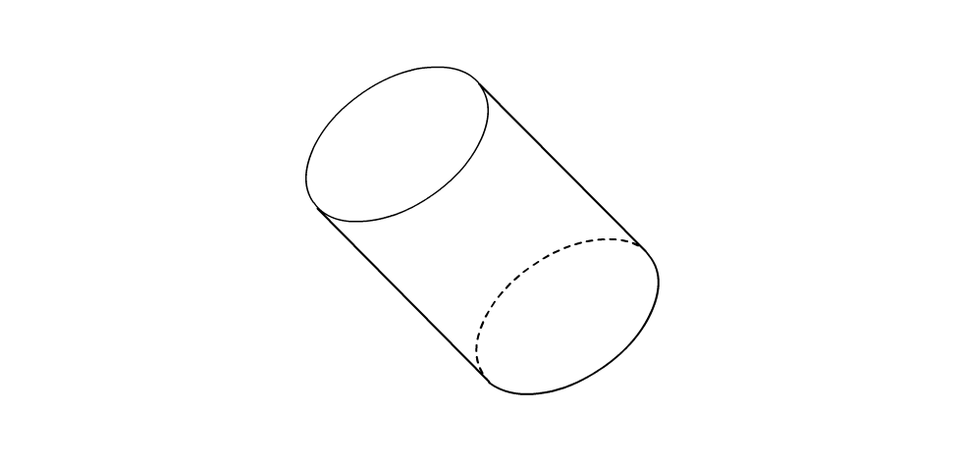
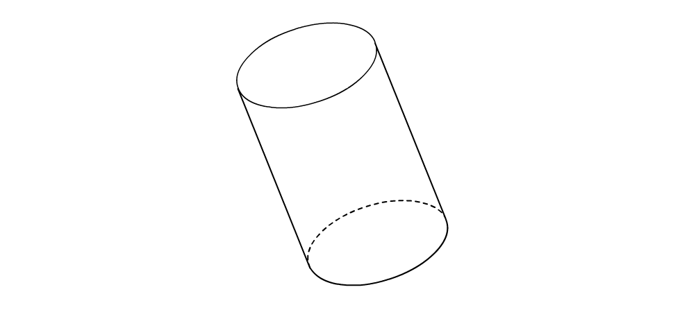
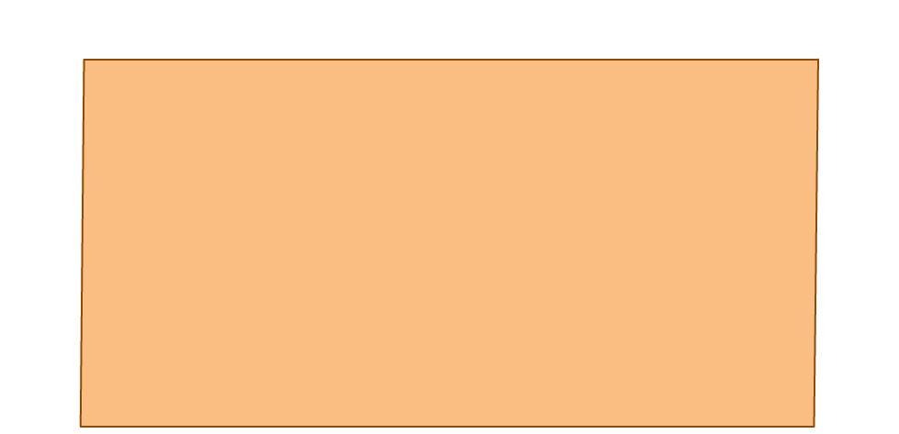
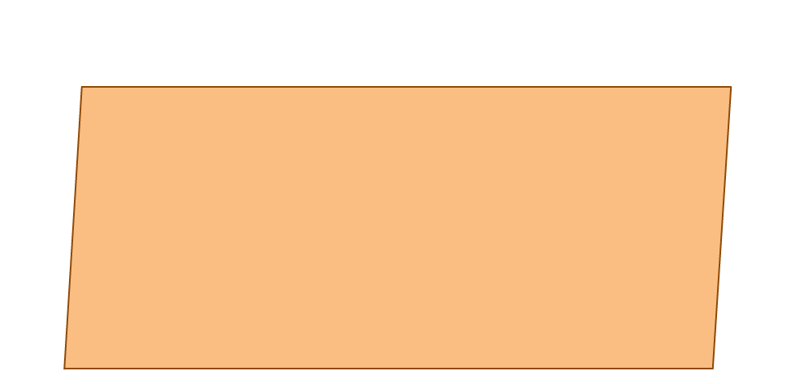
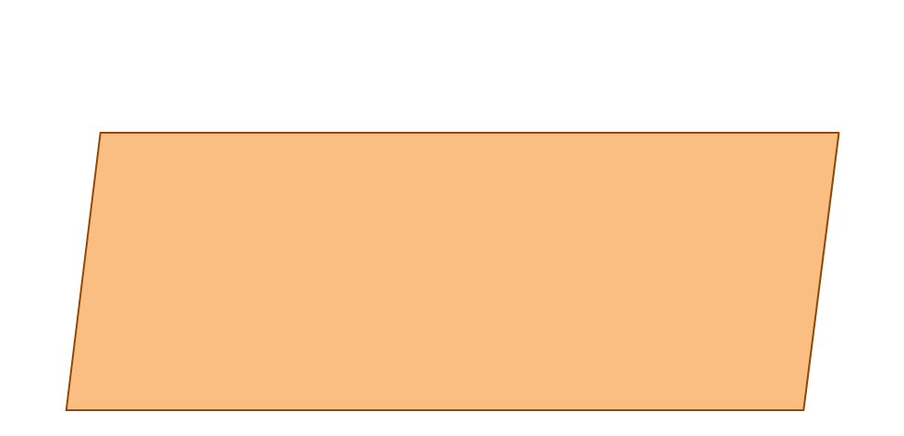
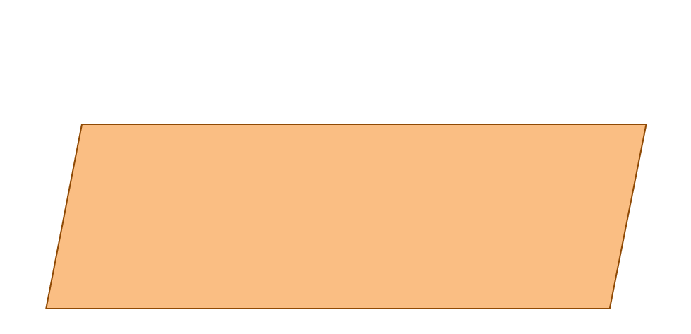
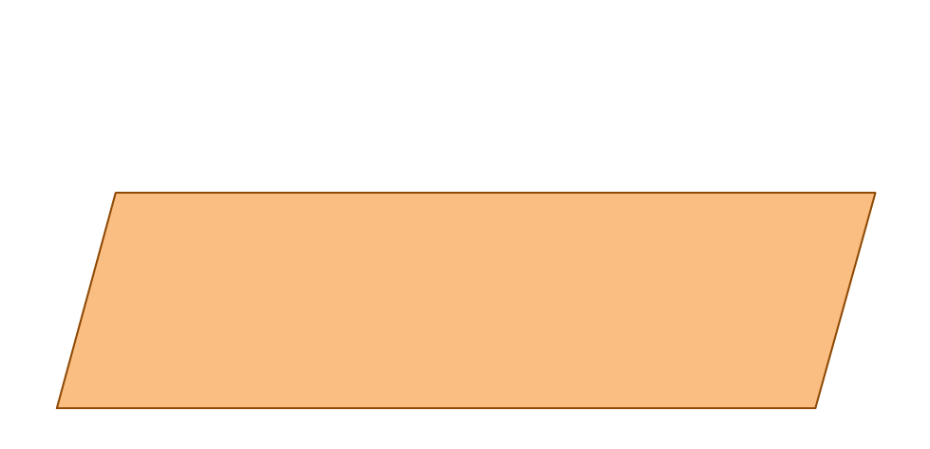
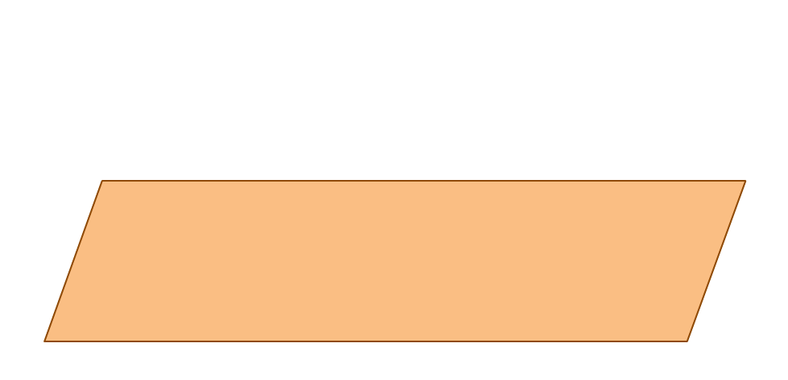
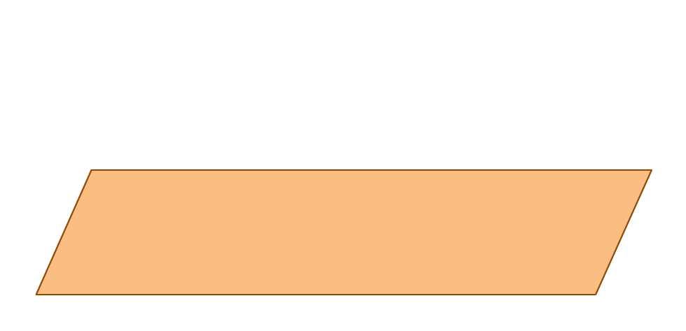
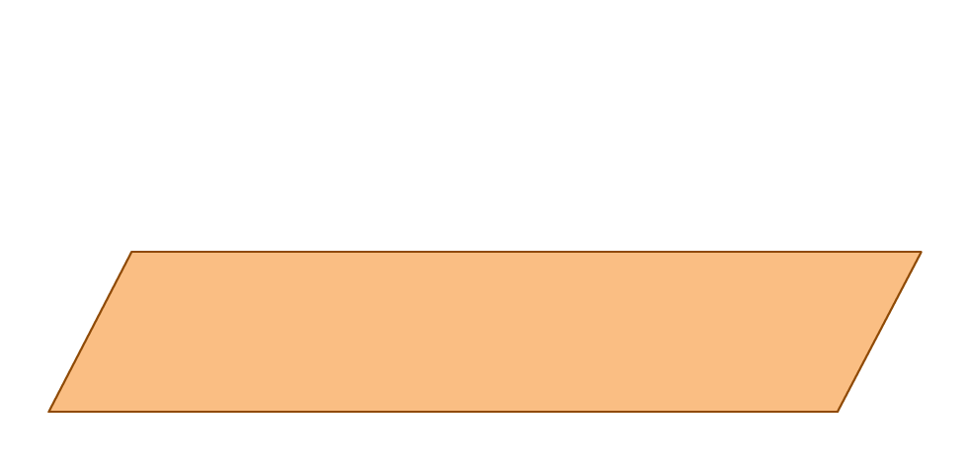
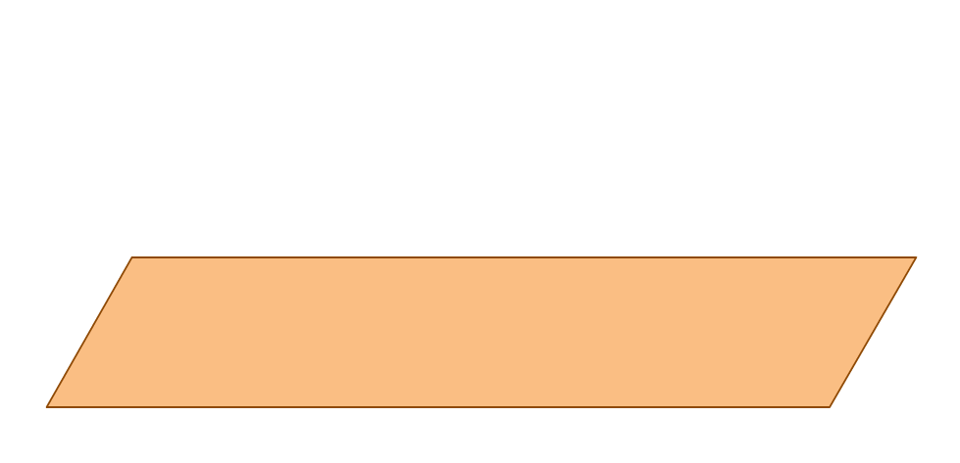
CURVED SURFACE AREA OF CYLINDER
When we fold the sheet, the
length of the sheet is equal to the
circumference of the base of the
cylinder
Let us fold this
sheet, to form a
cylinder
Let us first take a
rectangular-sheet of
length l and breadth b
Let the radius of the
cylinder be ‘r’ and
height be ‘h’
What is the area
of this sheet ?
The breadth of the sheet
is equal to the
height of the cylinder
l × b
b
l = 2πr
b = h
i.e. l = 2πr
i.e. b = h
Curved surface area = 2πrh
Area of the sheet =
l
Curved surface area of cylinder =
l
×
b
= 2πrh
What is the formula
of circumference for the
circle ?
2πr
2πr
h

Slide 9
Formulae
2. Total Surface Area =
2 π r (r + h)
Volume of the cylinder is
the capacity of the cylinder
What is the area of the
circular face ?
π r²
π r²
h
The horizontal surfaces of a
cylinder are equal and
parallel to each other
What is the height
of the cylinder ?
What is the area of this
circular base ?
3. Volume
=
πr² h
h
π r²
π r²
h
∴Volume of a cylinder = ?
r
Volume of cylinder =
Area of base
× height
Total surface area
of a cylinder
Curved surface area
of a cylinder
Area of two circular
faces
=
2πrh
+
2 × area of one
circular face
=
×
2 ×
=
2 π r
(r + h)
=
πr² h

Slide 10
MODULE : 14

Slide 11
Q. In figure, you see the frame of a lampshade. It is to be
covered with a decorative cloth. The frame has a base
The frame has a base
diameter of 20cm and height of 30cm. A margin of 2.5cm
diameter of 20cm and height of 30cm
is to be given for folding it over the top and bottom of the
frame. Find how much cloth is required for covering the
Find how much cloth is required for covering the
lampshade.
lampshade
Soln.
20
10
r =
cm
=
10cm
2
h = 30cm
+
2.5cm
+
2.5cm
=
30
+
5
=
35cm
Cloth required for covering the lampshade
=
Its curved surface area
=
2πrh
22
5
The cloth will be covering the curved surface of the cylindrical lampshade.
=
What is the formula for curved surface area of the cylinder ?
=
2
×
×
10
×
35
2200cm²
7
2πrh
∴ Cloth required for covering the lampshade is 2200cm²

Slide 12
Q. It is required to make a closed cylindrical tank of
height 1 m and base diameter 140 cm from a metal Sheet.
How many square meters of the sheet are required for the same ?
It is required to make a closed cylindrical tank of
height 1 m and base diameter 140 cm from a metal Sheet
How many square meters of the sheet are required for the same ?
Soln.
Let r be the radius of the base and h be the height of the cylinder.
140
2
⁷⁰
h = 1m,
r = cm
=
70 cm
=
0.70 m
Metal sheet required to make a closed cylindrical tank
= Its total surface area
Metal sheet required
to make a closed
cylindrical tank
Metal sheet required to make a closed cylindrical tank =
What is the formula for total surface area of a cylinder ?
=
2πr (h + r )
2 πr ( h + r )
22
7
^{0.1}
Total surface area of a cylindrical tank
?
=
2 ×
× 0.70
( 1
+ 0.70 )
=
2
× 22
× 0.1
× 1.70
= 7.48 m²
∴ The metal sheet required is 7.48 m²

Slide 13
Thank You

